Slide 1
Virtual Drum-kit
A presentation by
SaUrabh Challawar(160118737113)
and
Susheel Kumar(160118737117).

Slide 2
Problem statemaent
We know that the drum-kits are heavy and is not possible to always carry a musical instrument like drums. Musicians find it hard to transport drum-kits for practice sessions or even shows because it is hard to carry and transport drum-kits to different places.
It is also time consuming to setup a drum-kit.

Slide 3
Motivation
We know that the drum-kits are heavy and is not possible to always carry a musical instrument like drums. Musicians find it hard to transport drum-kits for practice sessions or even shows because it is hard to carry and transport drum-kits to different places. It is also time consuming to setup a drum-kit.
This project will help produce sounds of a drum-kit using a keyboard. It will be programmed using JAVA. Further this program can be used in sound pads or other hardware products to produce sounds of a drum-kit after configuration. This will make it easier for musician to carry it to different locations for practises or performances.

Slide 4
Objectives
To develop a system for musicians to play/practice drums without actually having a drum kit.
To make it portable, since a real drum kit is large and heavy for musicians to carry everywhere they go.
To give musicians more sound options.
To provide the users a system which works without internet connectivity.
To make mass people familiar with virtual musical instruments.

Slide 5
Methodology
java.io.File
java.io.FileInputStream
java.io.InputStream
javax.swing.JOptionPane
sun.audio.AudioPlayer
sun.audio.AudioStream
java.util.Scanner

Slide 6
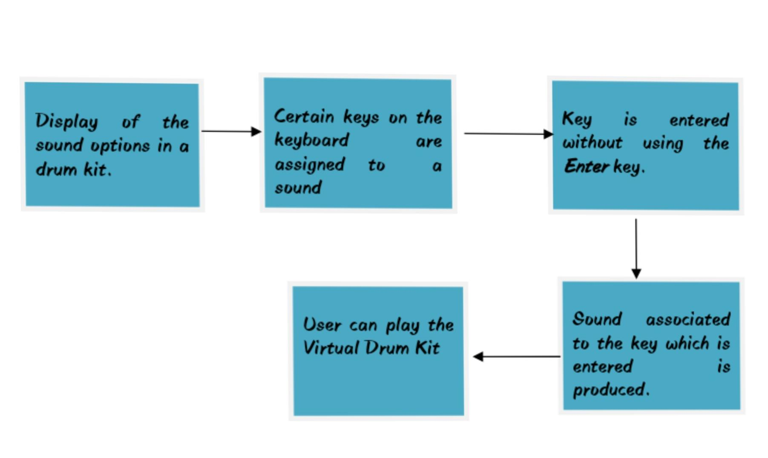
Flow chart of the project is shown below

Slide 7
Software and hardware requirements
A software requirements specification (SRS) is a description of a software system to be developed. Used appropriately, software requirements specifications can help prevent software project failure. The software requirements specification document lists sufficient and necessary requirements for the project development.
Computer hardware is a collective term used to describe any of the physical components of an analog or digital computer .the term hardware distinguishes the tangible aspects of a computing device from software, which consists of written instructions that tell physical components what to do.

Slide 8
S.No | Description | Requirement
 | Operating system | Windows 7 and above
 | Programming language | JAVA
 | Software | NetBeans 8.1 RC
 | processor | Intel Core™ i3
 | Ram | 1 GB or more
 | Disc space | 20 GB or more

Slide 9
Conclusion
We know that the drum-kits are heavy and is not possible to always carry a musical instrument like drums. Musicians find it hard to transport drum-kits for practice sessions or even for musical events because it is hard to carry and transport drum-kits to different places.
It is also time consuming to setup a drum-kit. This project is developed by using JAVA language.

Slide 10
Future scope
This project will help produce sounds of a drum-kit using a keyboard. Further this program can be used in sound pads or other hardware products to produce sounds of a drum-kit after configuration. This will make it easier for musician to carry it to different locations for practises or performances. This program can be used in a web application. This program can be used in sound pads after configurations. Sound pads are nothing but percussion keys replacing the keys of the computer keyboard. These sounds pads could made available at a very affortable price.
To make drum-kit portable.
To make setup easy.
To a drum kit available at anytime and any place.

Slide 11
bibliography
www.greeksforgreeks.com
www.udemy.com
www.quoara.com
Wikipedia
https://www.youtube.com/watch?v=r5Prfr4atWw
WWW.SampleSwap.org
FL Studio 20

Slide 12
THANK you!

